Slide 1
Region Select Game Walkthrough
using Knot Theory
성균관대 22학번 수학과 김종근

Slide 2

Index
Region Select Game?
Main Theorem
Use Algorithm
Knot theory

Slide 3

1. Region Select Game?

Slide 4
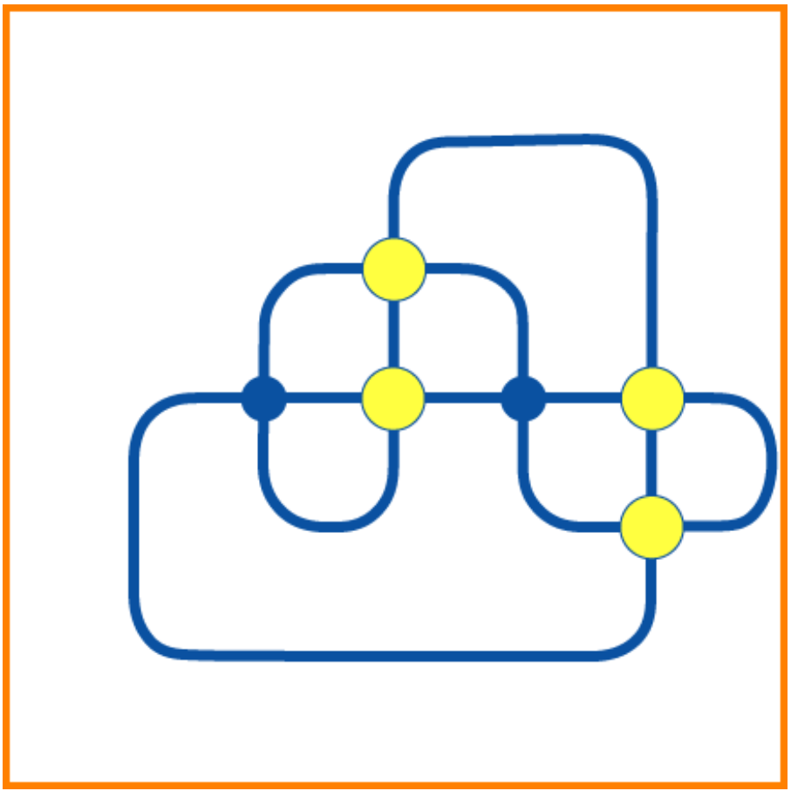
Do it!

Slide 5

Do it!

Slide 6
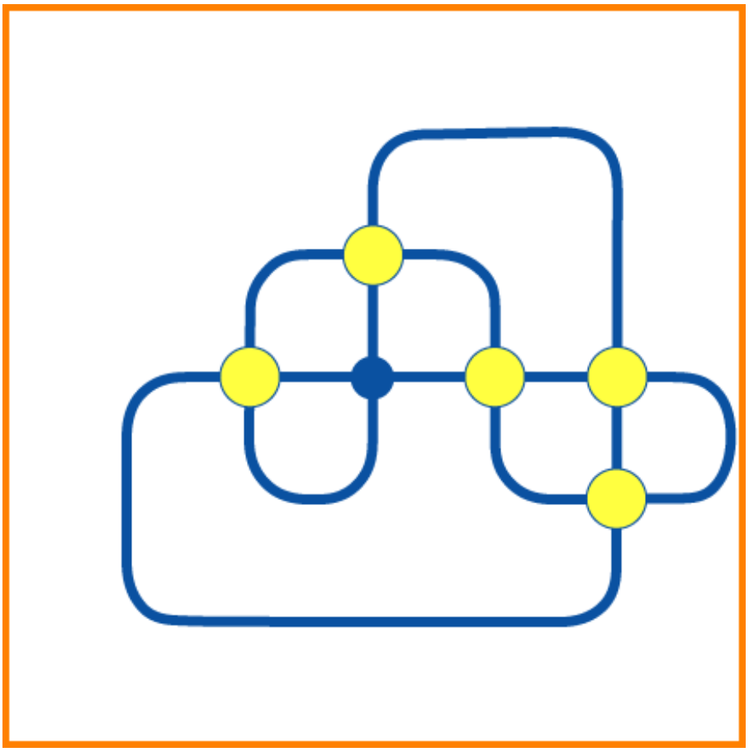
Do it!

Slide 7
Question.
어떤 상태로 시작하든 모든 전구를 다 킬 수 있을까?
어떤 전구를 하나만 킬 수 있는 알고리즘이 있을까?

Slide 8
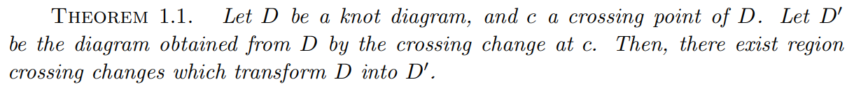
2. Main Theorem

Slide 9



Preliminaries
1.
So what is a knot?
Reference : https://en.wikipedia.org/wiki/Overhand_knot

Slide 10


Preliminaries
2.
Knot diagram

Slide 11

Preliminaries
3.
c
c

Slide 12


Preliminaries
4.
R1
R2
R3
R4
R5
R6
R7
R8

Slide 13


Preliminaries
5. Reduced, reducible
Reducible diagram
Reduced diagram

Slide 14


3. How to prove?
Corollary 1. 색칠한 곳에 전구를 다 켜도 원래 상태로 돌아온다.
Checkerboard coloring

Slide 15


3. How to prove?
Corollary 2. 색칠한 곳에 전구를 일부분 킨 것과 나머지 부분을 킨 것의 상태와 같다.

Slide 16
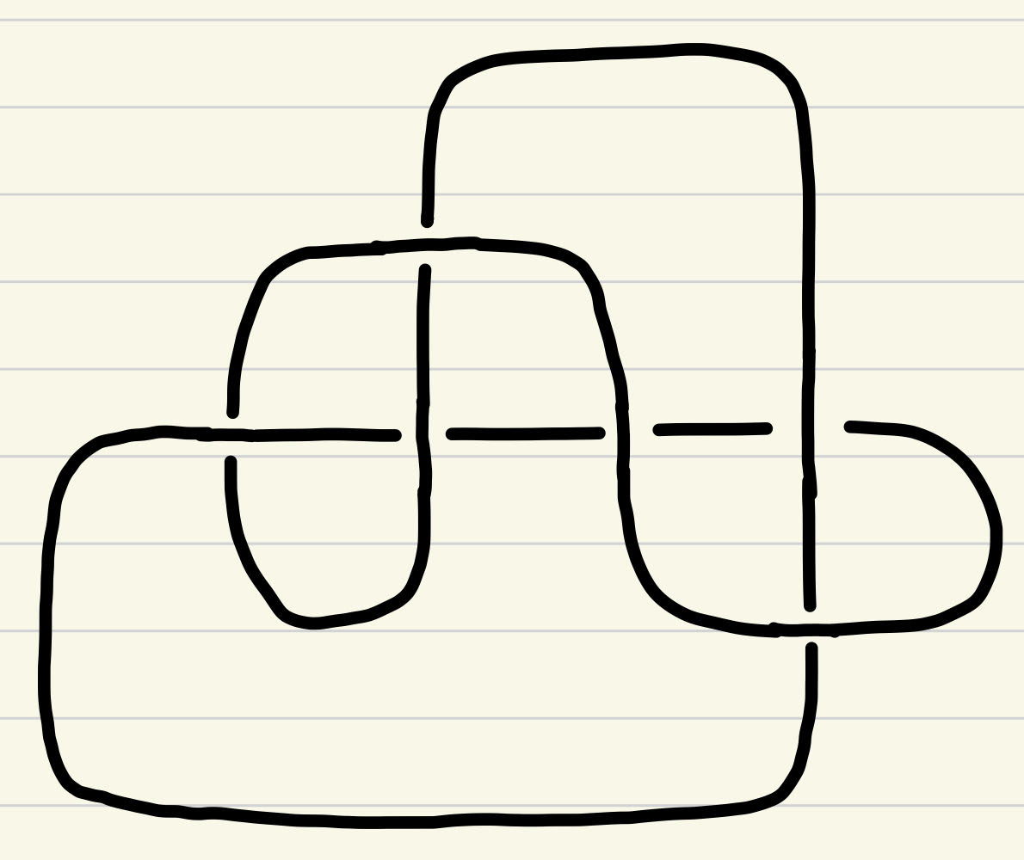
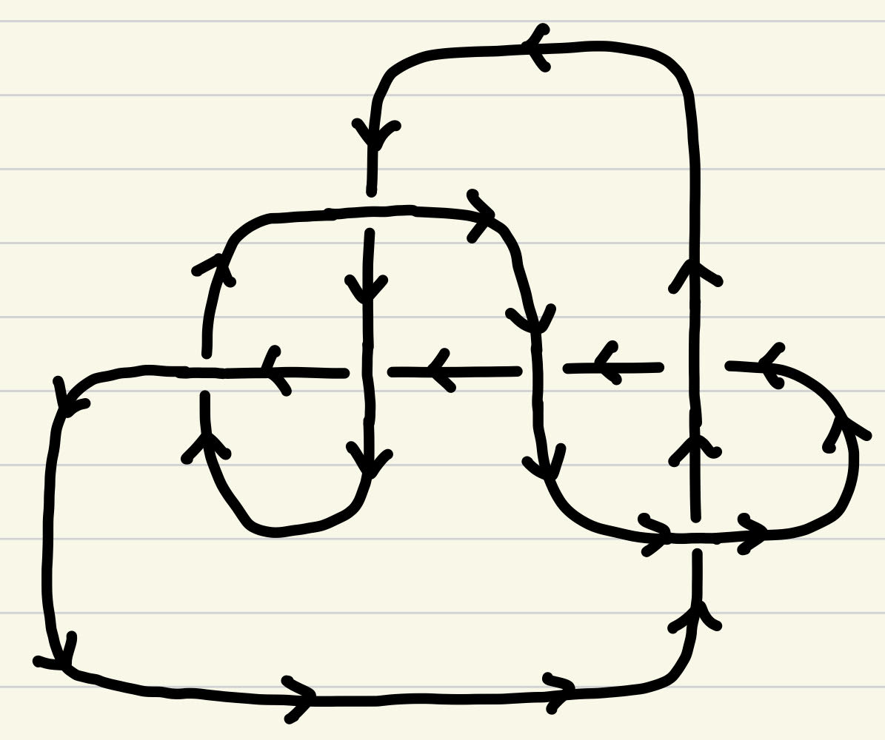
3. How to prove?
Step 1.
c
c

Slide 17
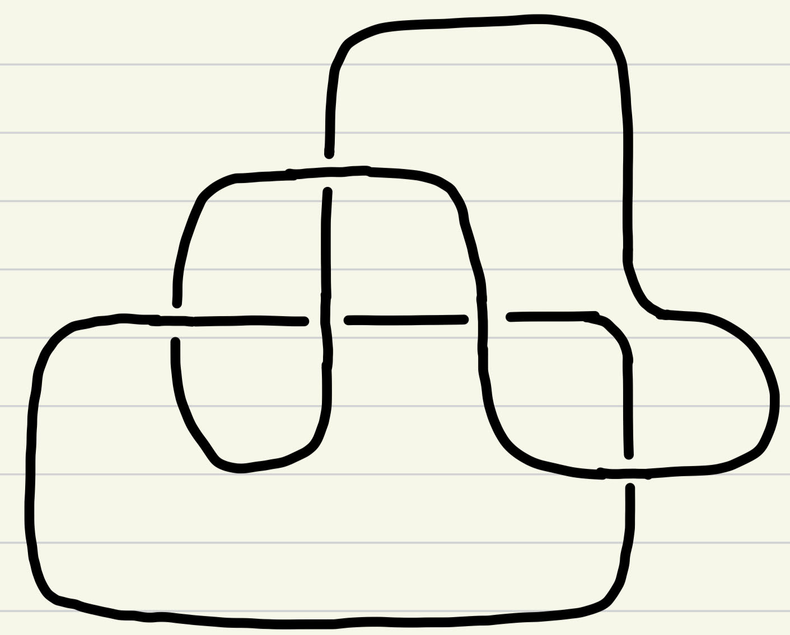
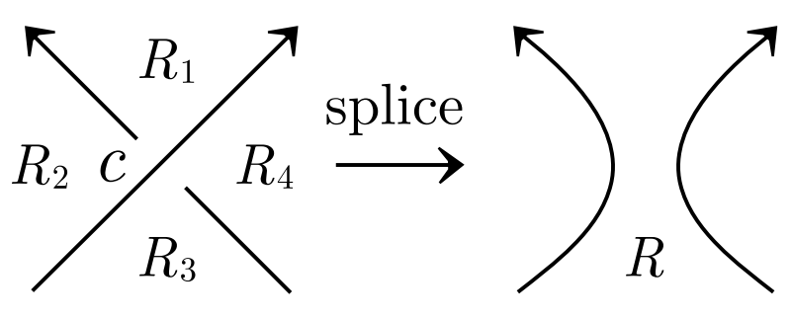
3. How to prove?
Step 2.
c
c

Slide 18
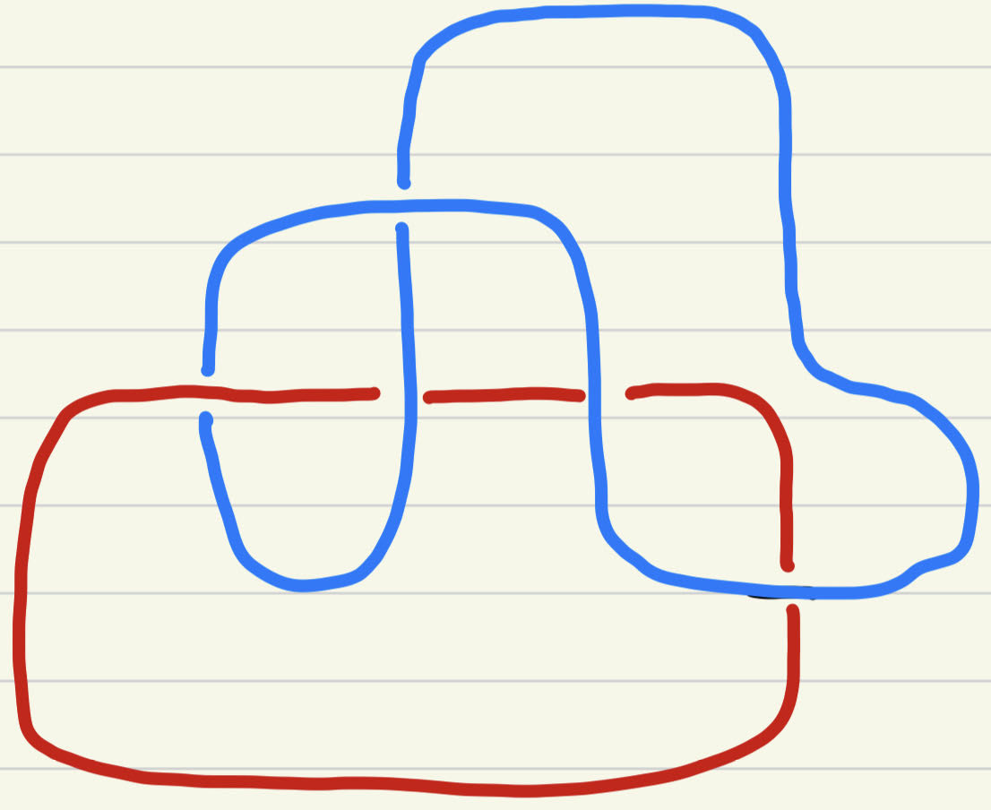
3. How to prove?
Step 3.
1
c
c
2

Slide 19
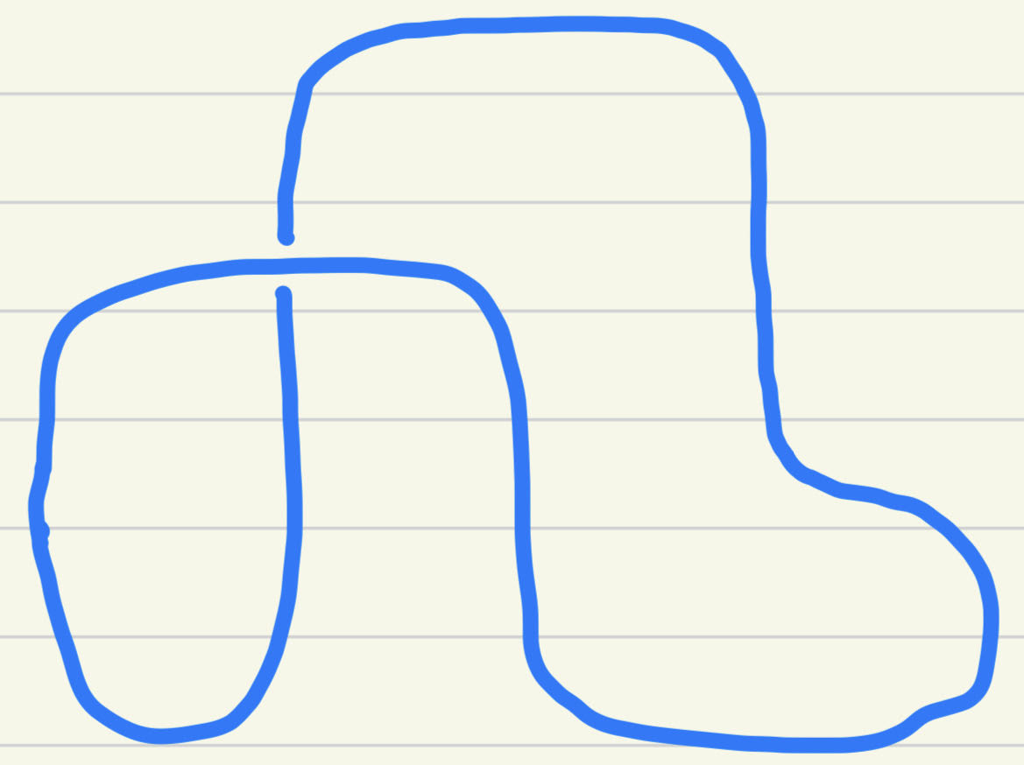
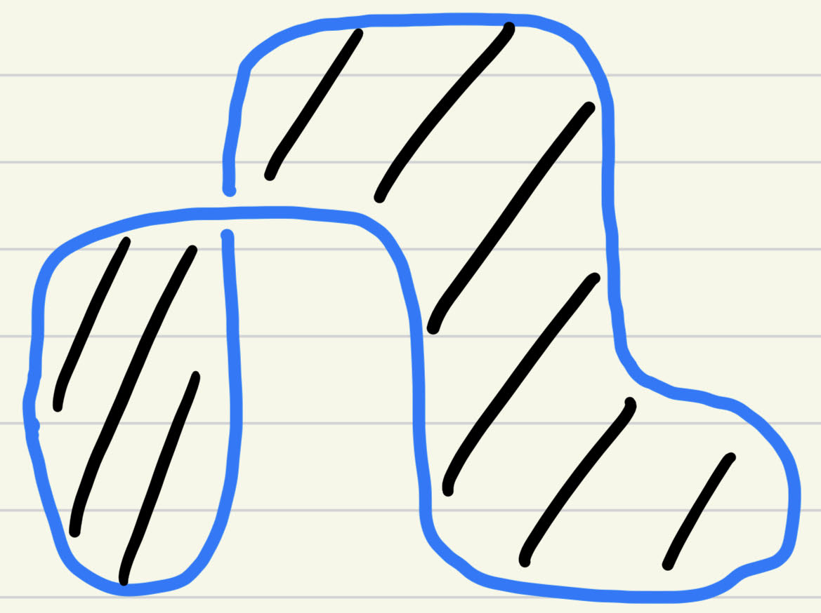
3. How to prove?
Step 4. Choose one component and checkerboard coloring.
1
1
Checkerboard coloring

Slide 20
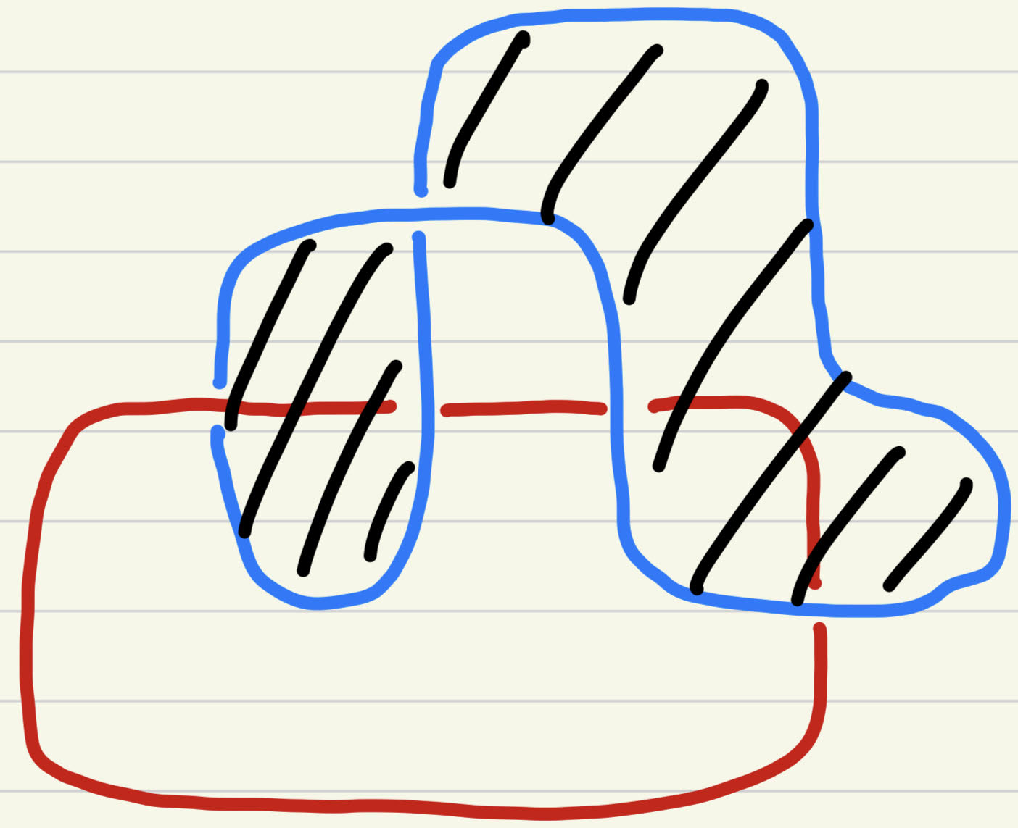
3. How to prove?
Step 5. Change crossing in shaded regions.
c

Slide 21
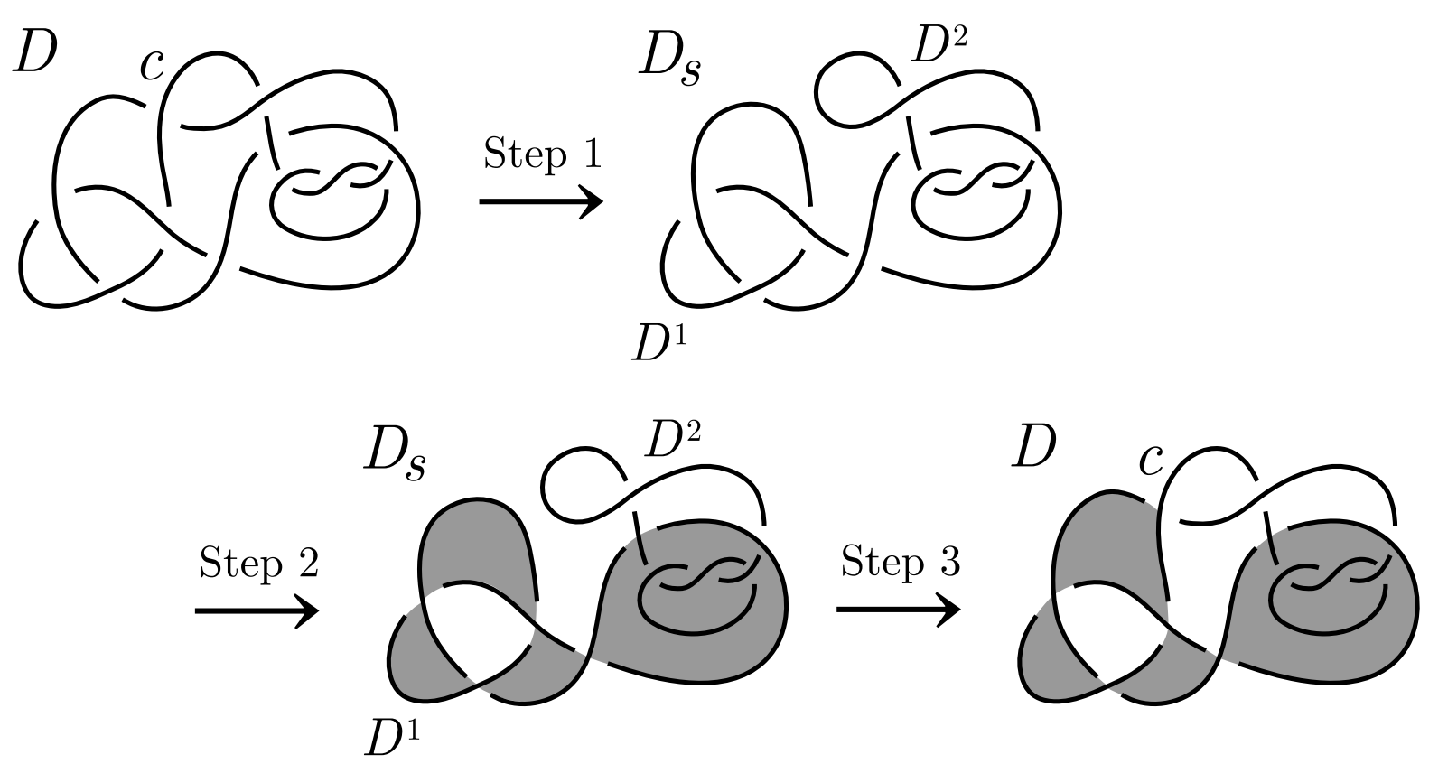
3. How to prove?

Slide 22
4. Use Algorithm!

Slide 23

5. Knot Theory
Are they same?

Slide 24
5. Knot Theory
https://knotinfo.math.indiana.edu/diagram_display.php?10_9

Slide 25
Source
https://www.sci.osaka-cu.ac.jp/math/OCAMI/news/gamehp/etop/gametop.html
Ayaka SHIMIZU. "Region crossing change is an unknotting operation." J. Math. Soc. Japan 66 (3) 693 - 708, July, 2014. https://doi.org/10.2969/jmsj/06630693

